Slide 1
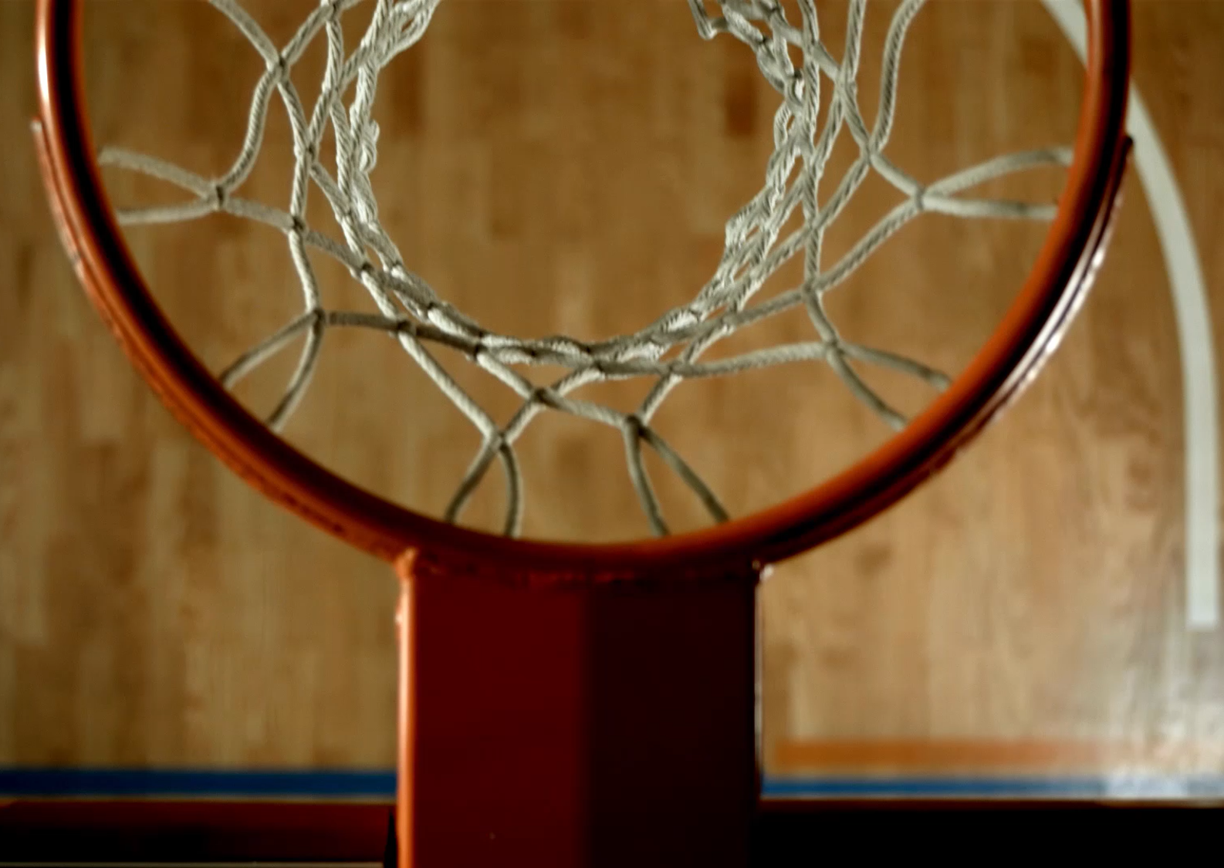
Training Basketball Officials
Game Management

Slide 2
Game Management
Definition
Elements That Effect
Additional Tips

Slide 3
Define Game Management
Game management refers to the strategies and decisions made during a game to control its flow and outcome.
It’s not just about applying the rules of the game by the book—anyone with a rulebook can do that. It’s about reading the game, understanding how the flow of play is evolving, and making decisions that maintain the integrity and spirit of the sport.
Good game management is all about finding that sweet spot.
Referees who master this skill earn the respect of players, coaches, and fans alike. And, most importantly, they help ensure that the match is fair, competitive, and safe.

Slide 4

Elements That Effect Game Management
Crew Makeup
Crew Consistency
Effective Communication
Style of Play
Level of Competition
Rivalry
Environment
Time & Score

Slide 5

Crew Makeup
Determined By Assignor
Leader or Crew Chief
Personalities
Respect Level
Belief

Slide 6
Crew Consistency
Play Calling
Fairness
Rules Application

Slide 7
Effective Communication
Crew
Prior to Contest
Pregame
During The Game – Verbal & Non-Verbal
Coaches
Players
Table

Slide 8
Styles Of Play
Type of Offense
1. Fast Paced
2. Slow Methodical
3. Driving to Basket
4. Jump Shooting
Type of Defense
Pass, Person to Person
Zone

Slide 9
Level of Competition
Even
Over Matched
Scrappy

Slide 10
Rivalry
Perceived
Hostile vs Friendly
Long or Short Term
Defined Over Time
Based on Previous Results

Slide 11
Environment
Confronting
Hostile
Controlled
Peaceful
Secure

Slide 12
Time & Score
Level of Accountability
Call Accuracy
Competitive Score or Blow Out
Sportsmanship

Slide 13
Game Management
Understanding Game Flow
Good referees are in tune with the flow of the game. They can sense when a game is heating up, when tensions are rising, and when it’s time to step in and cool things down.
For example, if two players are getting into it, a well-placed word or a brief pause in play can prevent things from boiling over. It’s about being proactive rather than reactive. A referee who waits for things to explode before stepping in is not managing the game—they’re just putting out fires.
On the flip side, if the game is flowing smoothly, constant interruptions can ruin the momentum. A good referee knows when to let minor infractions slide in favor of keeping the rhythm of the game intact. It’s a bit like dancing—sometimes you lead, sometimes you follow, but it’s all about keeping things moving in harmony.
Know the plays that could possibly causes issues.

Slide 14
Game Management
Body Language and Presence
You’d be surprised how much of refereeing comes down to body language. A confident stance, a calm demeanor, and assertive gestures can convey control without saying a word.
Referees also use their presence on the court to manage the game. For example, positioning themselves closer to two players who are getting heated can send a subtle message: “I’m watching you.” It’s a way of stepping in without actually stepping in.
On the other hand, if a referee looks hesitant or unsure, players will pick up on that and may try to push the boundaries. Confidence is key, even when it’s quiet confidence.

Slide 15
Game Management
Building Relationships with Players and Coaches
Referees who have a good rapport with players often find themselves in a better position to manage the game. This doesn’t mean being their best friend or going easy on them, but it does mean showing respect and fairness.
When coaches and players feel like a referee is approachable and human, they are more likely to accept decisions—even the ones they don’t agree with. Approachable and open to questions. A referee who is too distant or authoritarian can quickly lose the trust of the players, making the game harder to control.
A quick chat, a smile, or even a light-hearted comment can go a long way. It shows players that the referee is not just a rule-enforcer but someone who understands the game and their emotions.

Slide 16
Game Management
Communication
One of the most important tools in a referee’s toolkit is communication. And no, I’m not just talking about blowing the whistle or yelling instructions.
Referees use verbal and non-verbal communication to manage players and situations. A quick word to a player after a foul can defuse tension. Sometimes, just a stern look or a gesture can say everything that needs to be said—without stopping the game.
Think of it like parenting (bear with me here). If you jump in and discipline your kids every time they step out of line, it can create resentment. Similarly, if a referee is constantly blowing the whistle, players may feel like they’re being micromanaged. But subtle guidance, the occasional reminder, or a well-timed warning can keep things in check without being too overbearing.

Slide 17
Game Management
Consistency
Consistency is the secret sauce to good refereeing. Players need to know what to expect. If you let a certain level of physicality go unpunished for one team but then penalize the other team for the same thing, it creates frustration and confusion. And trust me, frustration leads to escalation, which leads to chaos.
It’s not just about applying the rules consistently but managing the game consistently. If you’ve set a certain tone in the first half, players should understand where the boundaries are in the second half.

Slide 18
Game Management
Definition
Elements That Effect
Additional Tips

